Slide 1
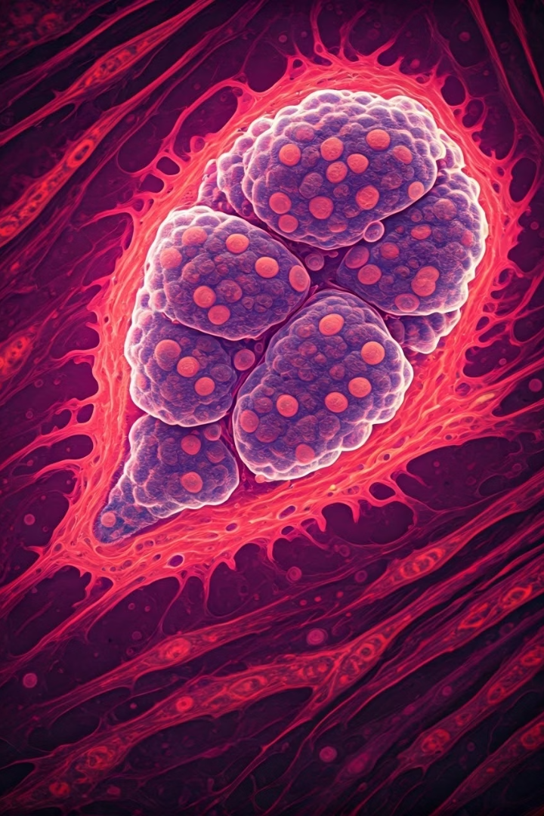
Automated Classification of Gastric Cancer Histopathology Image Patches
This project develops an automated pipeline to classify 224×224 histopathology image patches from gastric cancer slides into eight tissue types. The goal is to assist pathologists by highlighting regions of interest in whole-slide images, improving pre-screening efficiency.
Notes:
1

Slide 2
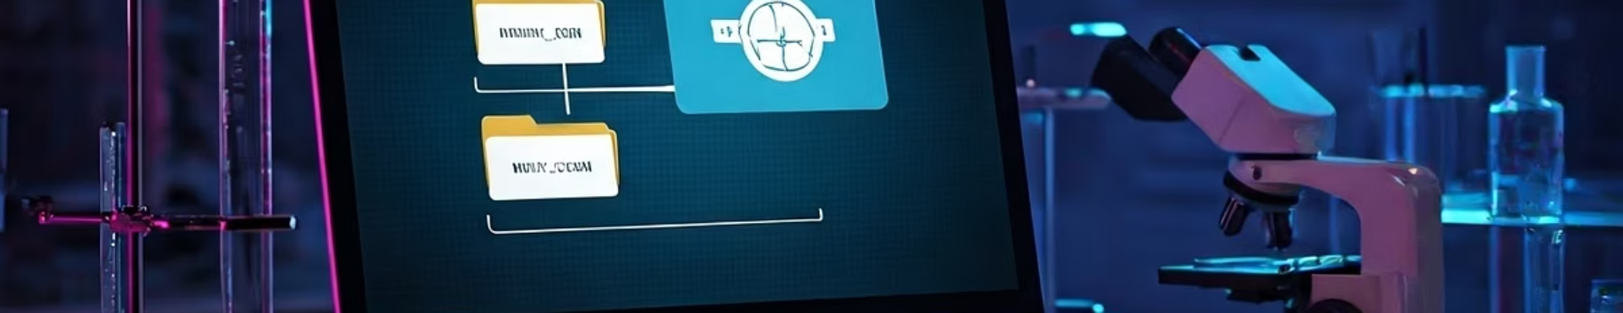
Data Exploration & Validation
Dataset Structure
Duplicate Analysis
31,096 images evenly distributed across eight classes: ADI, DEB, LYM, MUC, MUS, NOR, STR, and TUM. Images are organized in folders by tissue type.
Checked for duplicates using filename and pixel-wise hashing. Found 932 intra-class duplicates but no cross-class duplicates. Duplicates were retained due to no labeling conflicts.
Notes:
2

Slide 3
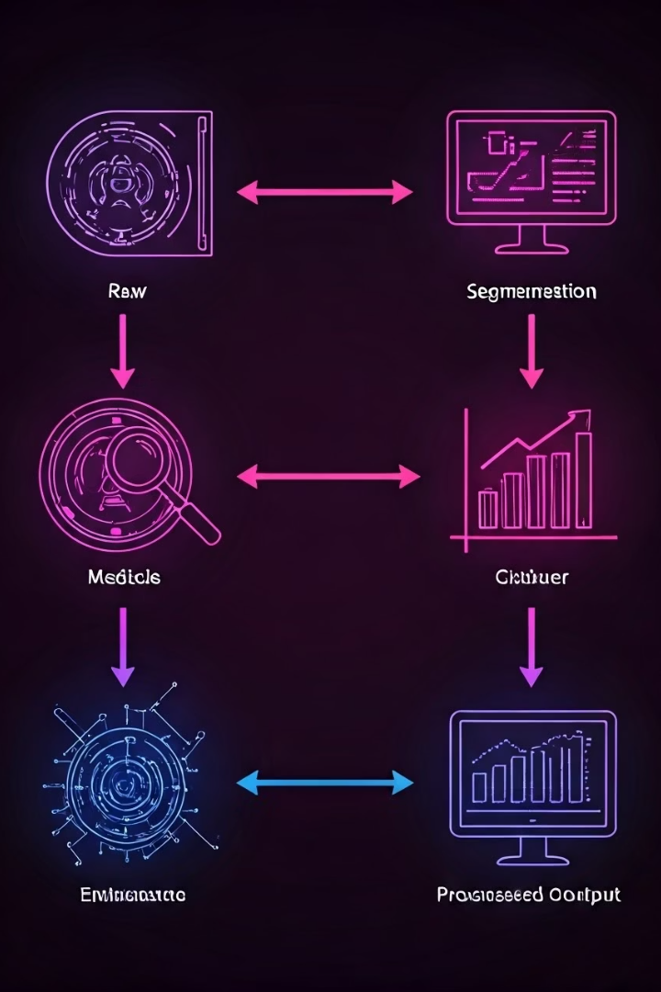
Preprocessing & Dataset Splitting
1
Train/Validation Split
2
Normalization
Pixel values rescaled to [0,1] using Rescaling(1./255).
80/20 split using TensorFlow's image_dataset_from_directory utility.
3
Optimization
Disabled in-memory caching to fit 12 GB RAM limit. Applied shuffling and prefetching for throughput.
Notes:
3

Slide 4
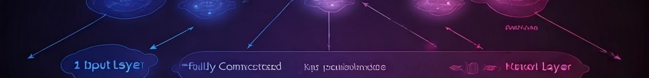
Model Architecture
Layer
Output Shape
Parameters
Input
(224,224,3)
0
Conv2D + ReLU
(224,224,32)
896
MaxPooling2D
(112,112,32)
0
Conv2D + ReLU
(112,112,64)
18,496
MaxPooling2D
(56,56,64)
0
Conv2D + ReLU
(56,56,128)
73,856
MaxPooling2D
(28,28,128)
0
Flatten
(100,352)
0
Dense + ReLU
(128)
12,845,184
Dropout (0.5)
(128)
0
Dense (Output)
(8)
1,032
Notes:
4

Slide 5
Training & Validation Results
Training Performance
Validation Performance
Trained for 20 epochs with early stopping. Training accuracy improved from 41% to 75%, and training loss decreased from 1.5 to 0.67.
Validation accuracy peaked at 56% and plateaued after epoch 10. Validation loss stabilized between 1.25 and 1.40, indicating overfitting.
Notes:
5

Slide 6
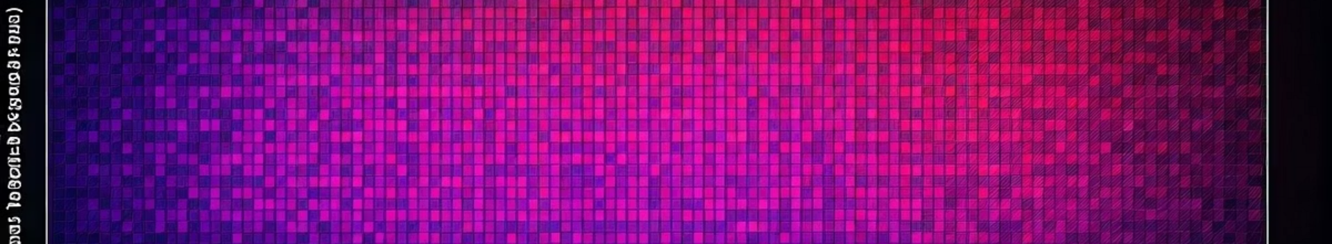
Performance Analysis
Overall Accuracy
Per-Class F1 Scores
Misclassification Patterns
Test set accuracy was 55.35% on 6,219 images.
ADI: 0.74
Common confusions occurred between MUC and ADI, STR and TUM, and NOR and STR classes.
LYM: 0.74
TUM: 0.55
DEB: 0.43
MUS: 0.36
NOR: 0.41
Notes:
6

Slide 7
Real-World Applicability & Limitations
Use Case
Limitations
The model serves as a pre-screening tool to flag tumor regions for pathologist review, aiding diagnostic workflow.
Moderate validation accuracy (56%) and single-center dataset limit generalizability. Dataset lacks staining variability, which may affect robustness.
Notes:
7

Slide 8





Recommendations & Future Work
Transfer Learning
Fine-tune pretrained models like ResNet50 to improve feature extraction.
Data Augmentation
Apply rotations, flips, and color jitter to increase dataset diversity.
Class Imbalance Handling
Use focal loss or class-aware sampling to address imbalance among tissue classes.
Notes:
8

Slide 9

Ethical & Regulatory Considerations
Augmentation, Not Replacement
Bias Mitigation
Validation on multi-center datasets is necessary to reduce bias.
The tool is designed to assist pathologists, not replace them.
Regulatory Compliance
FDA approval is required before clinical deployment.
Notes:
9

Slide 10

Conclusion
This project establishes a baseline gastric cancer tissue classification model with 56% accuracy. With enhancements like transfer learning and external validation, accuracy could reach 80–90%, enabling real-world clinical utility. The pipeline offers a promising foundation for assisting pathologists in cancer diagnosis.
Notes:
10

